Slide 1


Predictive Analysis of Ad-click Website data
Created by- Rahul Sisodia

Slide 2

Aim of the project
The goal of the case study is to Predict who is likely going to click on the Advertisement so it can contribute to the more revenue generation to the organization
Considering this objective, we are running a **Logistic regression model** on target/dependent variable to analyze the influence of several independent factors that affect our target variables .

Slide 3
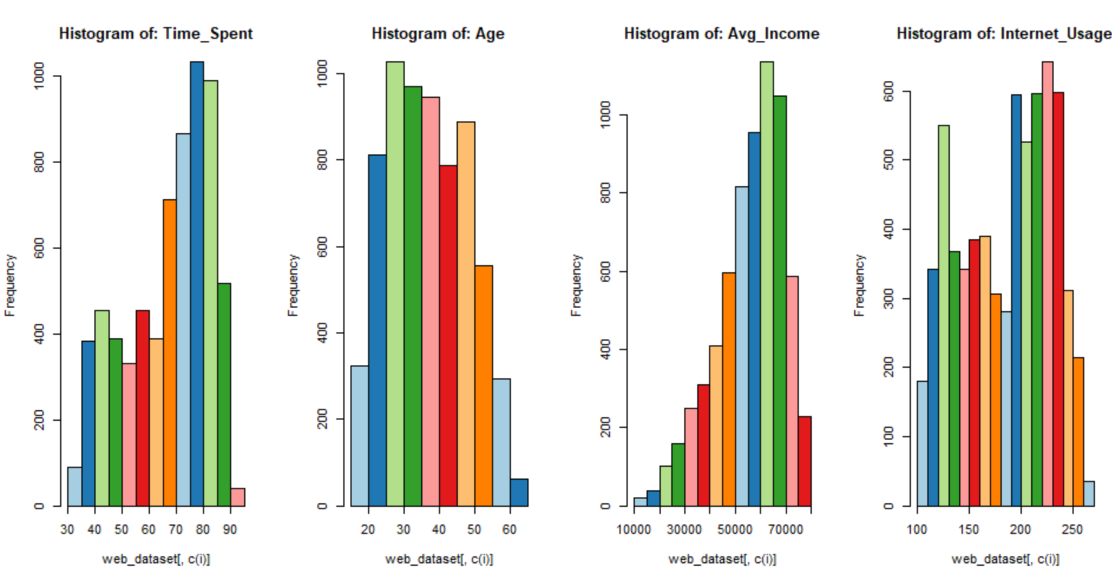
Univariate analysis:
Graphical representations makes your variable description easier to explain
Time spend is left skewed and user maximum time spend between 70 to 90
Average_income is also left skewed and , if the average_income between 50000 to 70000 has clicked more on Ad-website
Internet_usage maximum user used between 200 to 230

Slide 4
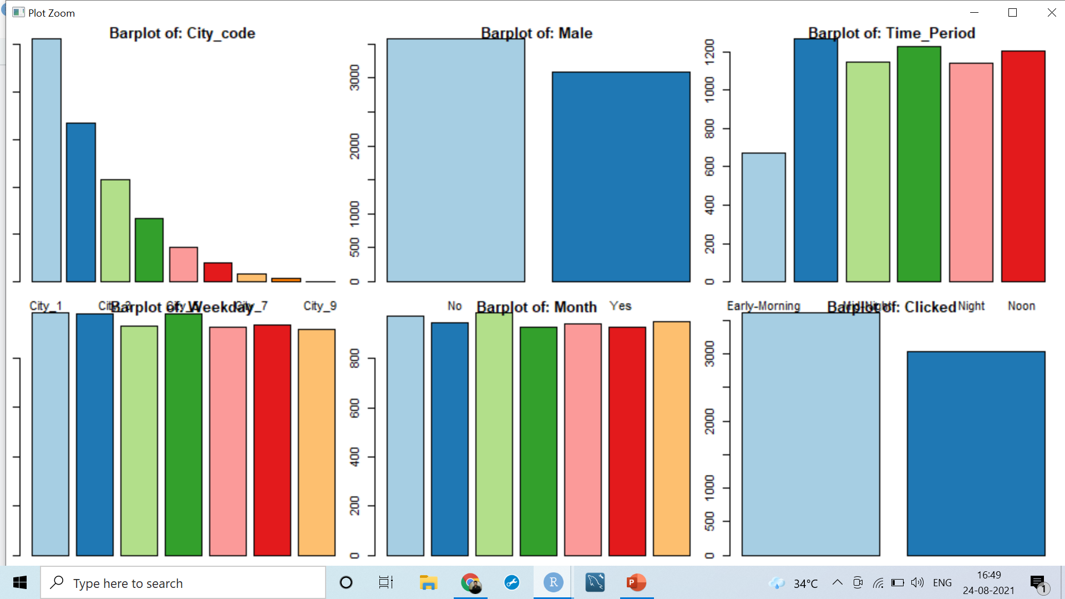
Univariate analysis:
City1 has clicked more on Ad-website
Number of user less in early morning as compared to other time
Number of unclicked is more than clicked in given dataset

Slide 5
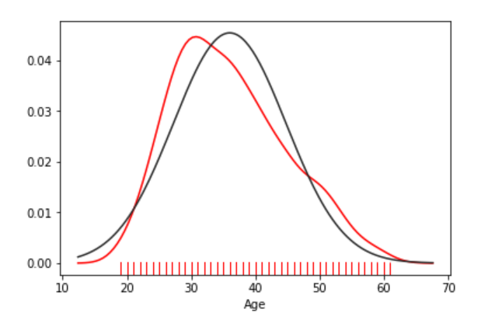
Univariate analysis
Age is normally distributed
Age is almost normally distributed, and age between 25 to 40 has more clicked on Ad-website

Slide 6
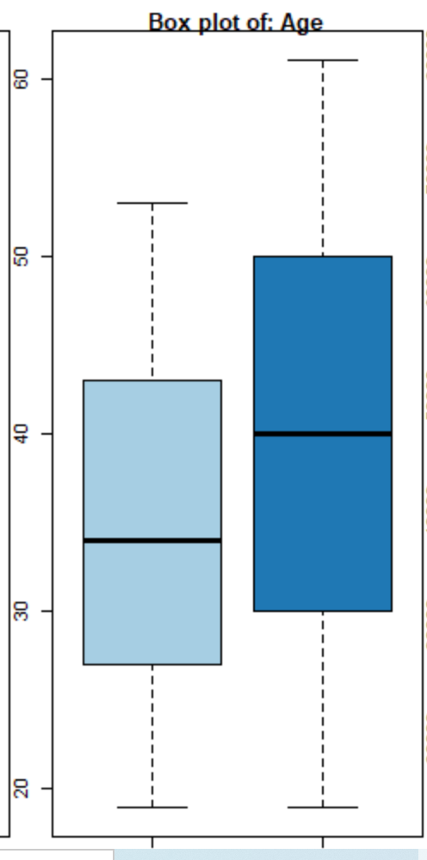
Bivariate analysis
The average age of a visitor is 36 years. We see that the youngest user is 19 and the oldest is 61 years old. We can conclude that the site is targeting adult users.
Maximum distribution is observed between the age of 20 and 45 years after which the distribution is dropping till 60 years of age.
This implies that users of the age between 20 and 45 years can be the main target group for the marketing campaign. Hypothetically, if we have a product intended for middle-aged user, this is the right site for advertising. Conversely, if we have a product intended for user over the age of 60, it would be a mistake to advertise on this site.

Slide 7
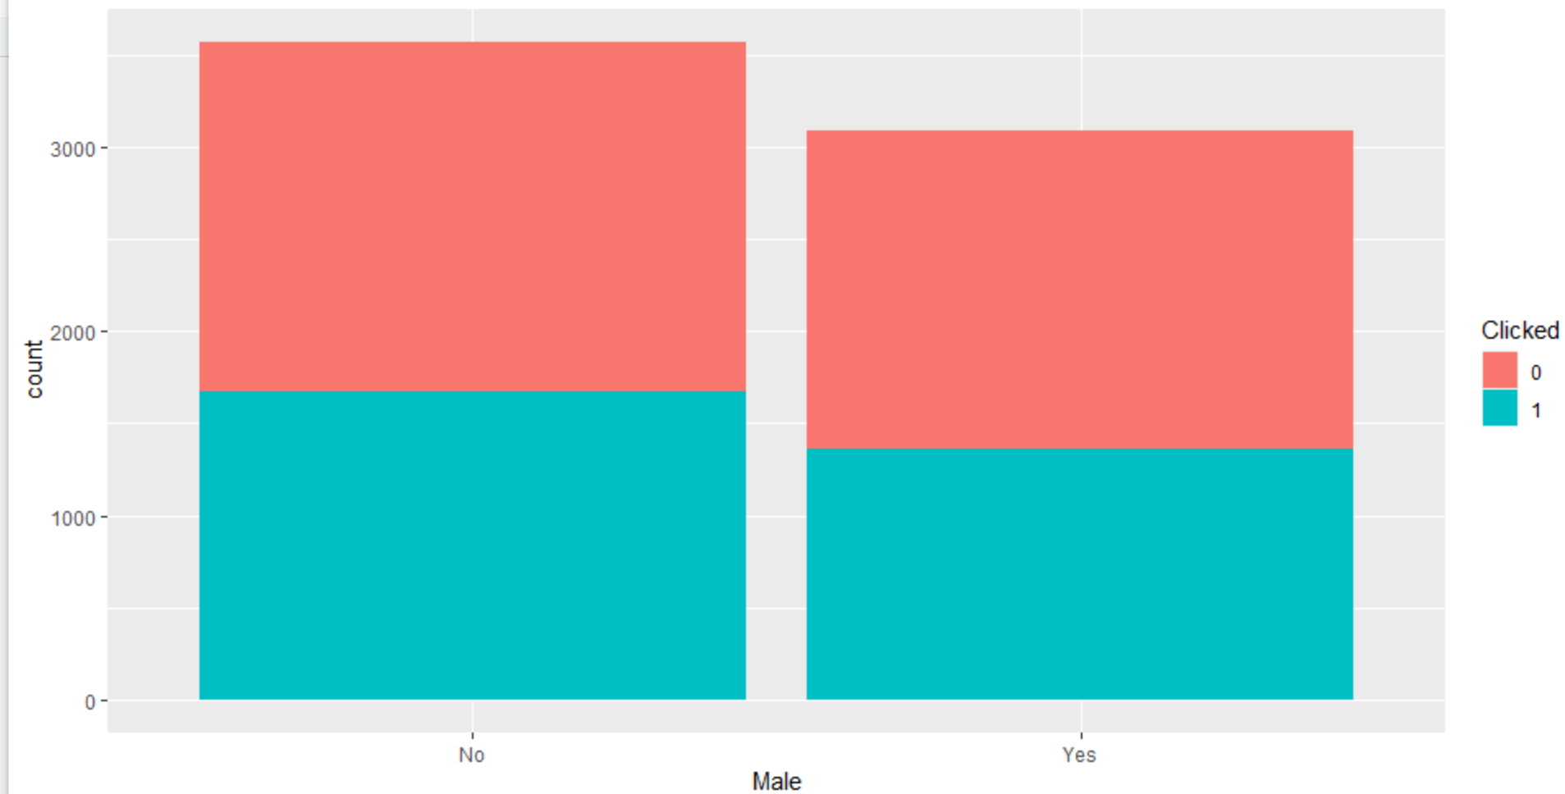
Bivariate analysis
Female has more clicked on Ad as compared to male Finally, if we are wondering whether the site is visited more by men or women, we can see that the situation is almost equal (52% in favor of women).

Slide 8
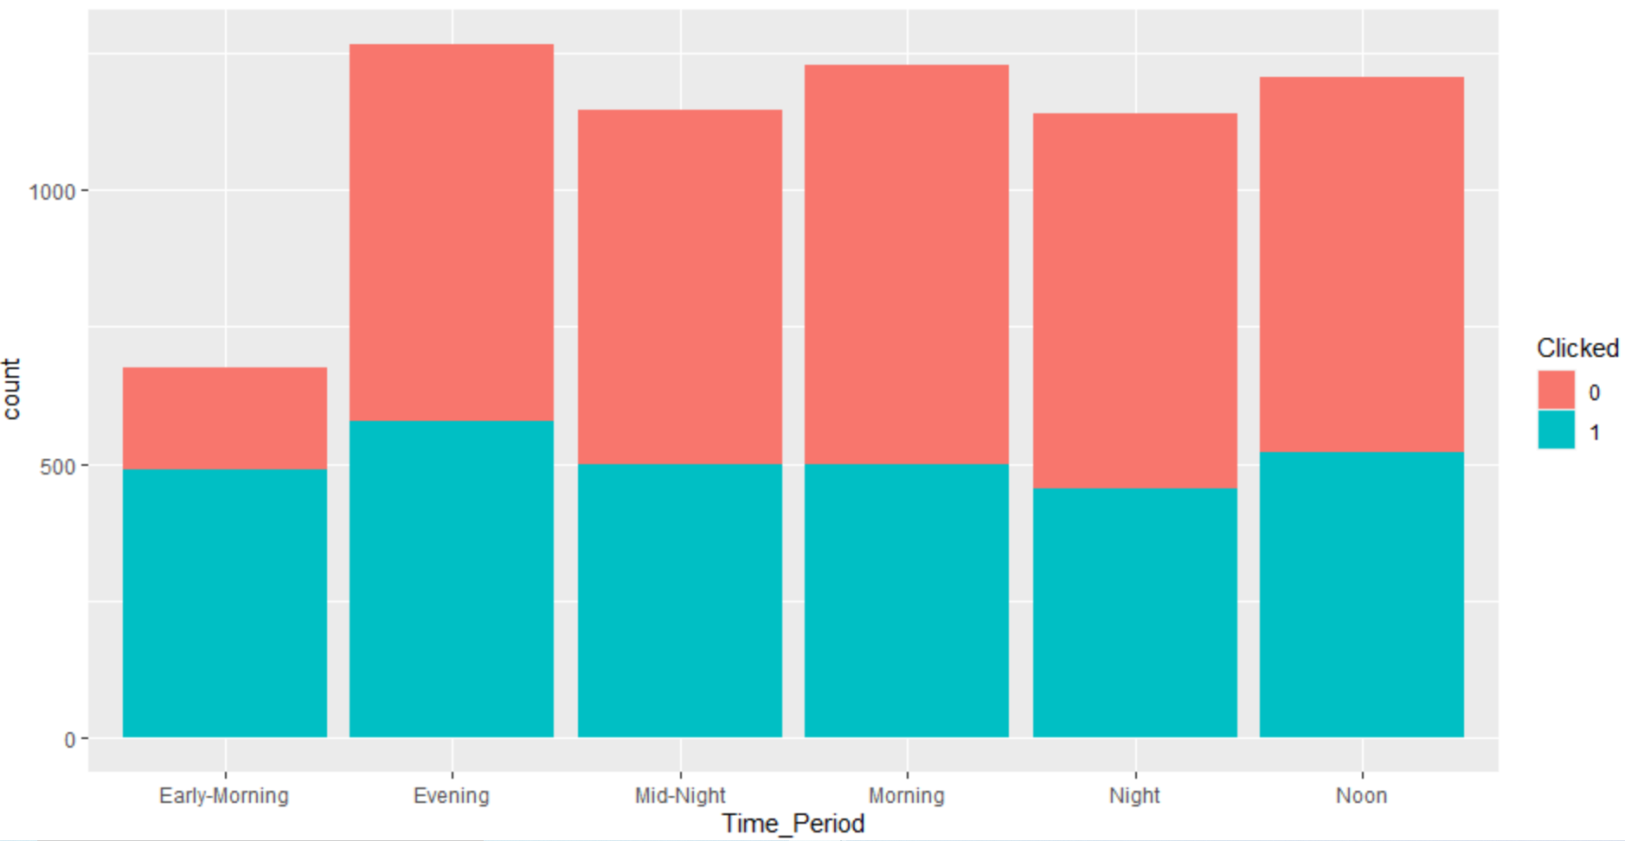
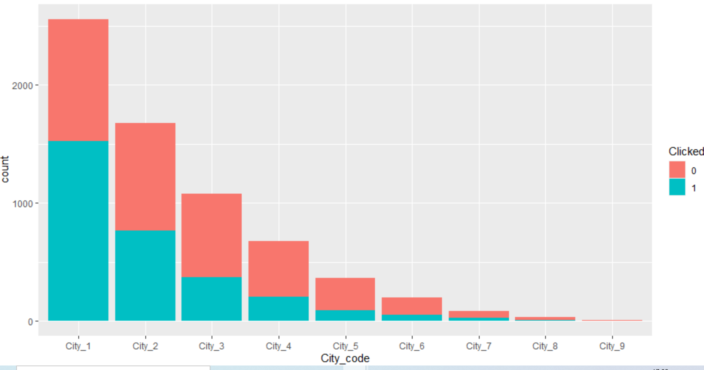
Bivariate analysis
In the city 1 has max no of clicked as compared to another city.
In the evening clicked are bit more as compared to other time.

Slide 9
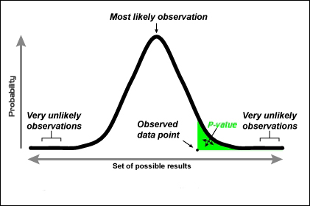
Statistical Relationship
Continuous Vs Categorical relationship strength: Analysis of Variance (ANOVA)
H0: Variables are NOT correlated
Small P-Value <5%--> Variables are correlated (H0 is rejected)
Large P-Value--> Variables are NOT correlated (H0 is accepted)
All variables are good for prediction because p-value less than 0.05
Categorical variables Vs Categorical variables -- Chi-square test
Column weekdays: p-value = 0.7226 and Column Month: p-value = 0.4229, We will not be considering these two variables in further analysis because the p- value is greater than 0.05

Slide 10
Significant variables:
Time_Spent
Age
Avg_Income
Internet_Usage
City_code
Time_Period

Slide 11
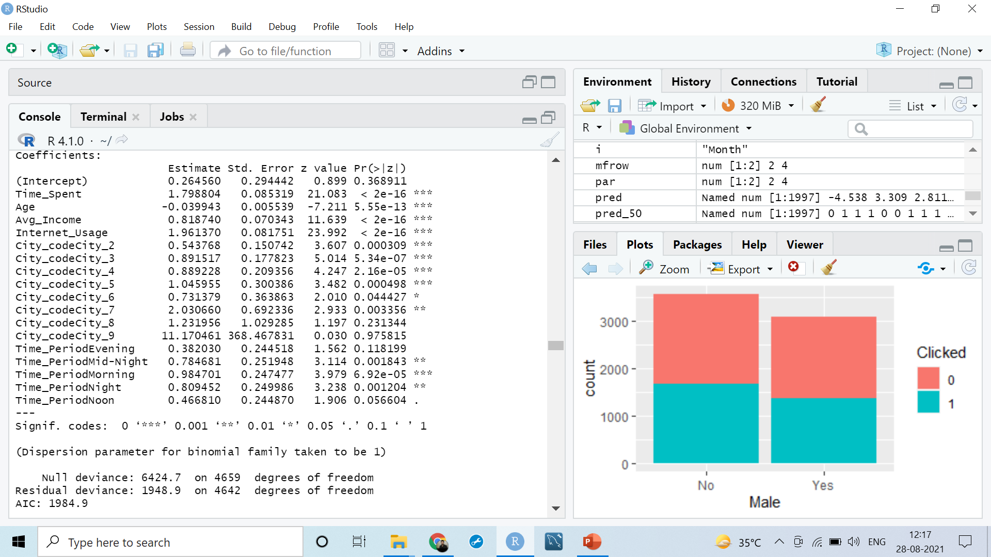
Model Building Logistic Regression
Technique of Maximum Likelihood Estimation The Maximum Likelihood Estimation (MLE) technique is used to estimate parameters in logistic regression.
The dataset is divided into two parts: a training dataset (4660 obs.) and a test dataset (1997 obs.).
Then, one by one, we will remove inconsequential variables from the training dataset based on high p-values in order to develop our training model.

Slide 12
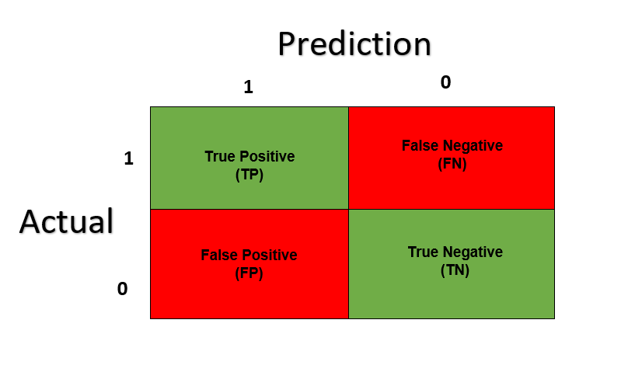
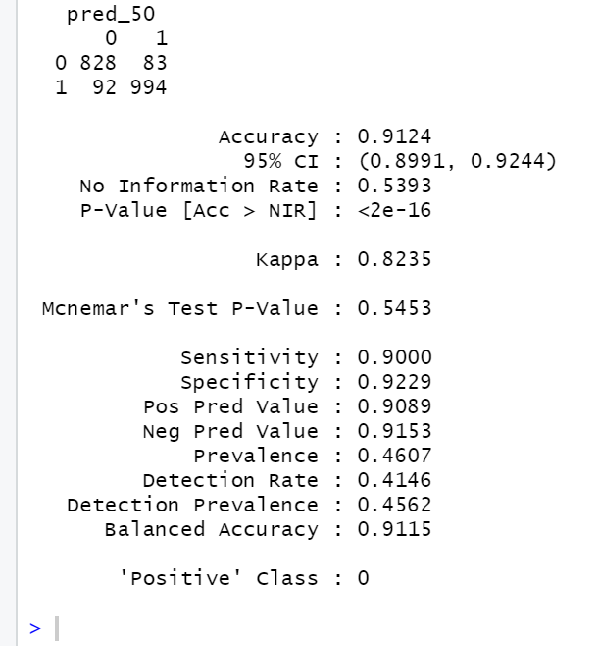
Predictions of the model
Using the obtained model, generate the prediction probabilities on the test data. Considering the threshold, obtain the predictions on the test data set.
considering the thresholds value 0.50
our model is 91% accuracy based on 95% of confidence interval accuracy lies between (0.8991, 0.9244)
Sensitivity/Recall: 0.9000
Specificity: 0.9229
Pos Pred Value/precision: 0.9089
we will calculate F1-score= 2*(recall* precision)/recall + precision
f1<- 2*(0.9000* 0.9089)/ (0.9000+0.9089)
f1 =0.9044281

Slide 13
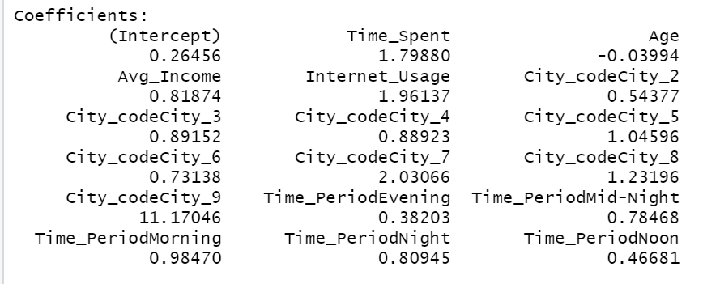
Hypothesis Interpretation
Age : People in their middle years are more likely to click on a website, and as they get older, they are 0.03 times less likely to click on an online ad.
Time_Spent: A user who spends more time on a website is 1.798 times more likely to click on an ad. If you spend more time on the internet, you're more likely to click on ads..
Avg_Income: A user's likelihood of clicking on a web ad increases by 0.818 times as their average income rises. Avg Income is more likely to click on a web ad with a higher Avg Income.
Internet_Usage : If a user spends more time on a website, he is 1.961 times more likely to click on an advertisement. Increased Internet Usage leads to a higher likelihood of clicking on a web ad.
City_codecity_2If City code is City 2, the user is 0.54 times more likely to click on the advertisement. This means that if the user's City code is City 2, he is more likely to click on the web advertisement.

Slide 14
Hypothesis Interpretation
City_codecity_3:The user is 0.891 times more likely to click on the ad if their City code is City 3. This suggests that a user with a City code of 3 is more likely to click on a web ad.
City_codecity_4: The user is 0.889 times more likely to click on the Ad if the City code is City 4. This means that if the user's city code is City 7, he will be able to click on the web advertisement..
City_codecity_9: If the user's City code is City 9, they are 211.17 times more likely to click on the ad. This means that if the user is from City code: City 7, they are more likely to click on the website, and they are more likely to click than users from other cities.
Time_PeriodMorning: Has 0.984 times likely to clicked on the Ad. Which is a bit higher than all the time.

Slide 15

Business Recommendation
It can be concluded that the variable 'Age' has a normal distribution of data. we can conclude that younger users spend more time on the site. This implies that users of the age between 20 and 40 years can be the main target group for the marketing campaign.
Hypothetically, if we have a product intended for middle-aged people, this is the right site for advertising.
Conversely, if we have a product intended for people over the age of 60, it would be a mistake to advertise on this site.

Slide 16

Thank You

